Slide 1
Oscilloscopes Fundamentals
For Engineering Students

Slide 2
Agenda
What is an oscilloscope?
Probing basics (low-frequency model)
Making voltage and timing measurements
Properly scaling waveforms on-screen
Understanding oscilloscope triggering
Oscilloscope theory of operation and performance specifications
Probing revisited (dynamic/AC model and affects of loading)
Using the Lab Guide and Tutorial
Additional technical resources
Notes:
Agenda
We will begin this presentation by defining what an oscilloscope is. We will then talk about the following:
Probing basics
Making measurements
Scaling waveforms
Understanding triggering
Theory of operation and specifications
Dynamic probe modeling and probe loading
Using the lab guide
Additional technical resources

Slide 3
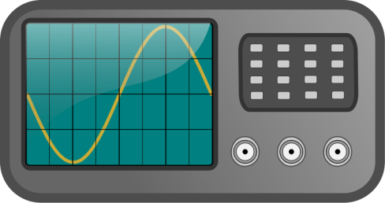
What is an oscilloscope?
os·cil·lo·scope (ə-sĭl'ə-skōp')
Oscilloscopes convert electrical input signals into a visible trace on a screen - i.e. they convert electricity into light.
Oscilloscopes dynamically graph time-varying electrical signals in two dimensions (typically voltage vs. time).
Oscilloscopes are used by engineers and technicians to test, verify, and debug electronic designs.
Oscilloscopes will be the primary instrument that you will use in your EE/Physics labs to test assigned experiments.
Notes:
What is an oscilloscope?
Oscilloscopes are an electronic instrument that convert electrical signals (primarily voltage) into a visible trace on a screen/display. In other words, they convert electricity into light.
These instruments dynamically graph time-varying electrical signals in two dimensions. On the “Y” (or vertical) axis of the scope’s display voltage is plotted, while time is plotted on the “X” ( or horizontal) axis. The resultant voltage versus time plot shows a “picture” of the input signal and is usually referred to as a “waveform”. As characteristics of the input signal change you can view continuous/dynamic updates of the plotted waveform on the scope’s display.
Oscilloscopes are the primary instrument that electrical engineers use to test and verify their electronic designs. This instrument will also be the primary instrument that you will use in your EE/Physics labs to test your assigned experiments.

Slide 4
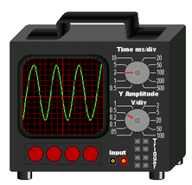
Terms of Endearment (what they are called)
Scope – Most commonly used terminology
DSO – Digital Storage Oscilloscope
Digital Scope
Digitizing Scope
Analog Scope – Older technology oscilloscope, but still around today.
CRO – Cathode Ray Oscilloscope (pronounced “crow”). Even though most scopes no longer utilize cathode ray tubes to display waveforms, Aussies and Kiwis still affectionately refer to them as their CROs.
O-Scope
MSO – Mixed Signal Oscilloscope (includes logic analyzer channels of acquisition)
Notes:
Terms of Endearment (what they are called)
Oscilloscopes go by a variety of different names, but the most common term used today for an oscilloscope is simply a “scope”. You will also hear them called a “DSO”, which stands for digital storage oscilloscope, “Digital Scope”, and Digitizing Scope”. These last three terms refer to the newer digital technology used in these instruments to digitally capture and store waveforms.
Older technology oscilloscopes are usually called “Analog Scopes”. This is the type of scope your professor may have used during his/her undergraduate studies.
If you happen to be from Australia or New Zealand, an oscilloscope is usually referred to as a “CRO” - pronounced “crow” - which is short for Cathode Ray Oscilloscope. Although most of today’s newer digital oscilloscopes primarily utilize digital flat-screen display technology to display waveforms as opposed to older cathode ray tube technology, Aussies and Kiwis still affectionately referred to them as their “CROs”.
“O-Scope” is another common term. And lastly, you will sometimes hear the term “MSO”, which stands for mixed signal oscilloscope. An MSO is basically a DSO with additional logic analyzer channels of acquisition.

Slide 5
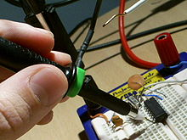
Probing Basics
Probes are used to transfer the signal from the device-under-test to the oscilloscope’s BNC inputs.
There are many different kinds of probes used for different and special purposes (high frequency applications, high voltage applications, current, etc.)
The most common type of probe used is called a “Passive 10:1 Voltage Divider Probe”.
Notes:
Probing Basics
Measuring electrical signals on an oscilloscope requires getting the desired signal to be tested into the scope’s input BNC connectors. If you want to measure the output of generator, you would typically connect the output of the generator directly to the input of the scope using a standard 50-Ω BNC or SMA cable. But if you want to measure the characteristics of a signal at a point in your circuit/design, you would typically achieve this using an oscilloscope “probe”.
There are many different kinds of probes used for different and special purposes such as high frequency applications, high voltage applications, and current measurements. But the most common type of oscilloscope probe used to test a broad range of signals is called a “passive 10-to-1 voltage divider probe”. This is the type of probe that you will use for most of your assigned electrical lab experiments.

Slide 6
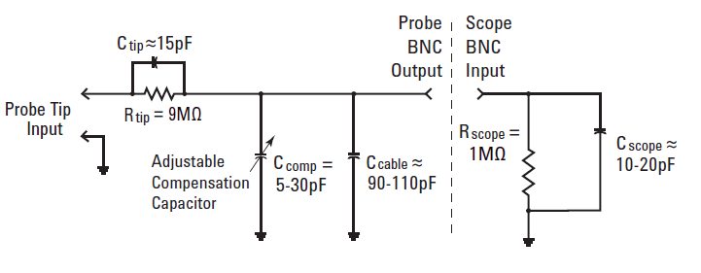
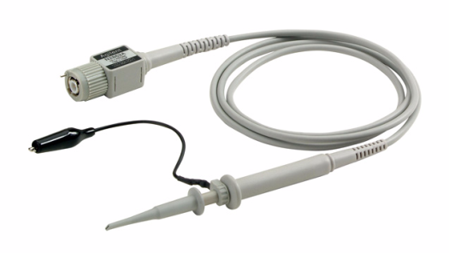
Passive 10:1 Voltage Divider Probe
Passive 10:1 Probe Model
Passive: Includes no active elements such as transistors or amplifiers.
10-to-1: Reduces the amplitude of the signal delivered to the scope’s BNC input by a factor of 10. Also increases input impedance by 10X.
Note: All measurements must be performed relative to ground!
Notes:
Passive 10:1 Voltage Divider Probe
Here we show an electrical model of a passive 10:1 voltage divider probe connected to the input of a scope. The term “passive” means that the probe includes no active circuitry such as transistors and amplifiers. In other words, the probe consists entirely of passive elements/components including resistance, capacitance, and inductance.
“10:1”, pronounced 10-to-1, means that the probe reduces the amplitude of the input signal by a factor of 10 through means of a resistive voltage-divider network. The oscilloscope measurement system’s input impedance (Z of probe + scope) is also typically increased by a factor of 10.
Lastly, note that all measurements using this type of probe must be performed relative to ground. In other words, you should connect the probe’s input tip to the desired test point and you must connect the probe’s ground lead/clip to the circuit’s ground. With this type of probe you cannot measure voltage across two mid-circuit components. This type of differential measurement would require a special differential active probe.
Note also that you should never attempt to complete a circuit using an oscilloscope probe.

Slide 7
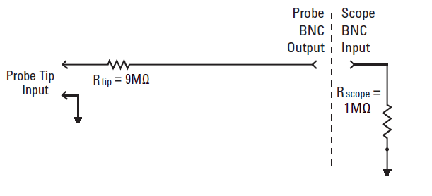
Low-frequency/DC Model
Passive 10:1 Probe Model
Low-frequency/DC Model: Simplifies to a 9-MΩ resistor in series with the scope’s 1-MΩ input termination.
Probe Attenuation Factor:
Some scopes such as Keysight’s 3000 X-Series automatically detect 10:1 probes and adjust all vertical settings and voltage measurements relative to the probe tip.
Some scopes such as Keysight’s 2000 X-Series require manual entry of a 10:1 probe attenuation factor.
Notes:
Low-frequency/DC Model
For low-frequency or dc measurement applications, our oscilloscope probe model can be significantly simplified by removing all of the capacitive elements shown in the model from the previous slide. What’s left is just a 9 MΩ resistor near the probe tip in series with the scope’s standard 1 MΩ input termination. Using Ohm’s Law, you can see that the voltage level of the signal at the scope’s input BNC will then be 1/10th the voltage level at the probe tip.
V_{scope} = V_{tip} x 1MΩ/(1MΩ + 9MΩ)
Most of today’s scopes have probe attenuation factors that will automatically compensate voltage measurements so that they will be reported relative to the probe tip. Some scopes, such as Keysight’s 3000 X-Series, automatically detect that a 10:1 probe has been connected. And some entry-level scopes, such as Keysight’s 2000 X-Series, require that the user manually enter the probe attenuation factor. Once the probe attenuation factor has either been automatically detected by the scope or manually entered by the user, the scope then provides compensated readouts of all voltage measurements. For example, if you connect a 10:1 probe to a 5 V dc power supply, the scope actually “sees” a 0.5 V dc signal at its input BNC. But with the 10:1 probe attenuation factor, the scope will report that it “sees” a 5 V dc signal at the probe’s tip.
We will address a more accurate ac/dynamic model of a passive 10:1 voltage divider probe later. This will also be covered in more detail during hands-on lab #5.

Slide 8
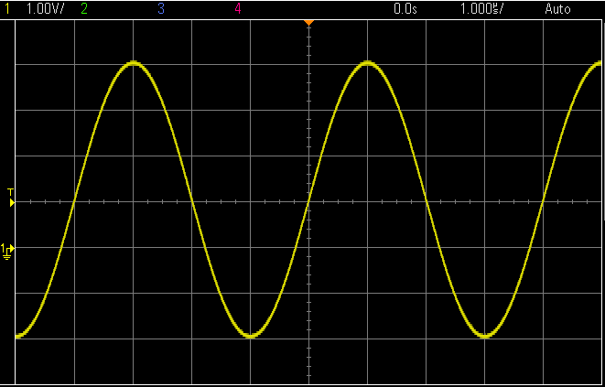
Understanding the Scope’s Display
Vertical = 1 V/div
Horizontal = 1 µs/div
1 Div
1 Div
Volts
Time
Waveform display area shown with grid lines (or divisions).
Vertical spacing of grid lines relative to Volts/division setting.
Horizontal spacing of grid lines relative to sec/division setting.
Notes:
Understanding the Scope’s Display
Once you use a probe to get a signal into the scope, you can then setup the scope’s vertical and horizontal scaling to begin making measurements. As mentioned earlier, the oscilloscope displays captured waveforms in a X versus Y format. Voltage (amplitude of the signal) is plotted on the Y axis while time is plotted on the X axis.
The waveform display area is divided into grid lines – sometimes referred to as “divisions”. On the vertical axis there are 8 vertical divisions. Each vertical division, or spacing between horizontal grid lines, is equal to the scope’s Volt/division setting which is displayed in the upper left-hand corner of the display. In this example since the scope’s vertical scaling is set to 1 V/div, the delta voltage between each horizontal grid line is 1 Volt. And the maximum peak-to-peak amplitude that the scope can possibly measure at this setting (1 V/div) is 8 Vpp (8 divisions x 1 V/div).
On the horizontal axis there are 10 horizontal divisions. Each horizontal division, or spacing between each vertical grid line, is equal to the scope’s sec/division setting. This is displayed near the upper right-hand corner of the scope’s display. In this example since the scope’s horizontal scaling is set to 1 µs/div, the delta time between each vertical grid line is 1 µsec. And the maximum time that can be measured across the scope’s screen is 10 µsec (10 divisions x 1 µsec/div).

Slide 9
Making Measurements
Visual estimation – The most common measurement technique
Vertical = 1 V/div
Horizontal = 1 µs/div
V max
V p-p
Ground level (0.0 V) indicator
Period
Period (T) = 4 divisions x 1 µs/div = 4 µs, Freq = 1/T = 250 kHz.
V p-p = 6 divisions x 1 V/div = 6 V p-p
V max = +4 divisions x 1 V/div = +4 V → V min = ?
Notes:
Making Measurement – by visual estimation
There are several ways to make voltage and time measurements on the plotted waveform, but the most common method is by visual estimation. Engineers that are familiar with their scopes can make quick estimations to determine the amplitude and timing of their signals. In this example, since the period of the input signal repeats every 4 divisions and since the horizontal scaling is set to 1 µs/div, we can quickly determine that the period (T) of this signal is approximately 4 µs (4 divisions x 1 µs/div), and hence the frequency is 250 kHz (Freq = 1/T).
To determine the peak-to-peak amplitude of this signal we can see that this waveform expands vertically approximately 6 division at 1 V/div, so the peak-to-peak amplitude is approximately 6 Vpp (6 divisions x 1 V/div).
To measure the absolute peak voltage of the signal, we must first locate the ground indicator/icon on the left side of the graticule. This point defines the 0 V level. We can then see that the positive peak amplitude (Vmax) of this signal is approximately 4 divisions above the ground indicator, and hence the positive peak voltage of this signal is approximately +4 V above ground (+4 divisions x 1 V/div).
Now, determine the negative peak amplitude (Vmin) of this signal.

Slide 10
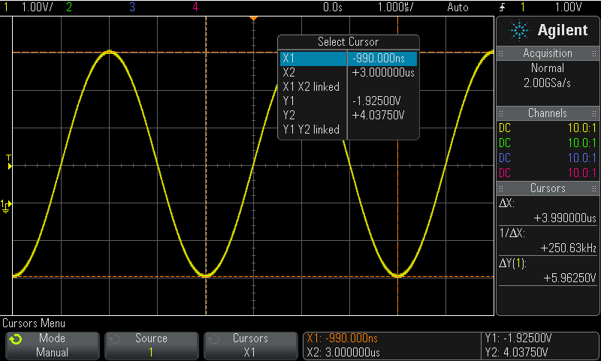
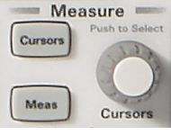
Making Measurements
Using cursors
Y2 Cursor
X1 Cursor
Cursor Controls
X2 Cursor
Δ Readout
Y1 Cursor
Absolute V & T Readout
Manually position X & Y cursors to desired measurement points.
Scope automatically multiplies by the vertical and horizontal scaling factors to provide absolute and delta measurements.
Notes:
Making Measurements – using cursors
A more precise and more accurate method to make voltage and timing measurements is to use the scope’s X and Y cursors. When the cursors are turned on, we can see horizontal and vertical cursors/markers that automatically display the voltage and time of the location the cursors. The absolute voltage and time of each cursor is displayed at the bottom of the screen, as well as delta voltage and delta time between the cursors are displayed on the right side of the screen. To measure the peak-to-peak voltage of this waveform, simply adjust the Y1 and Y2 cursors to the top of bottom of the waveform. To measure the period and frequency of this waveform, adjust the X1 and X2 cursors to two consecutive locations on the waveform where the waveform crosses a specific voltage/threshold level.

Slide 11
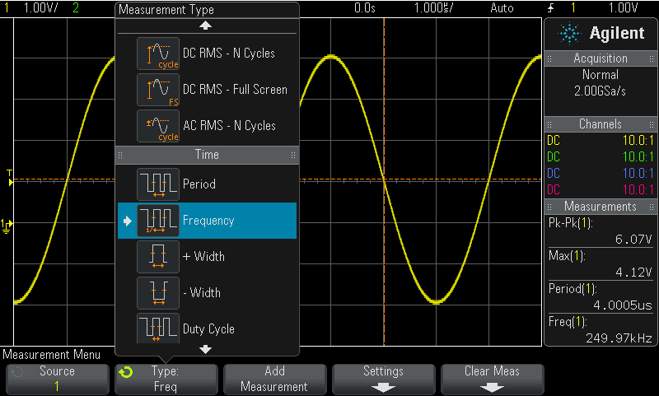
Making Measurements
Using the scope’s automatic parametric measurements
Readout
Select up to 4 automatic parametric measurements with a continuously updated readout.
Notes:
Making Measurements – using the scope’s automatic parametric measurements
In addition to using the scope’s user-adjusted cursors to make measurements, an even faster method to make measurements is to use the scope’s automatic parametric measurements. Most of today’s more advanced digital storage oscilloscopes have the ability to automatically measure voltage and timing parameters such as Vpp, Vmax, Vmin, Period, Frequency, Rise Time, Fall Time, etc.

Slide 12
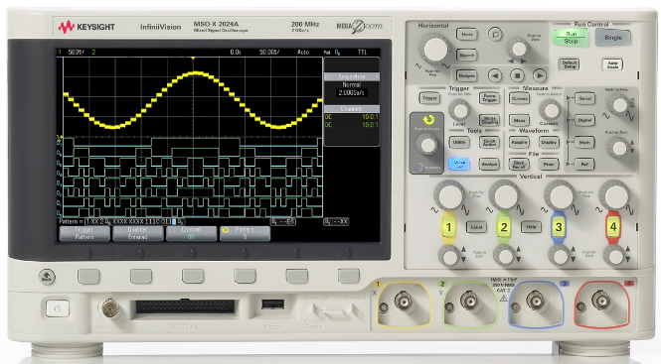
Primary Oscilloscope Setup Controls
Keysight’s InfiniiVision 2000 & 3000 X-Series Oscilloscope
Horizontal Scaling (s/div)
Trigger Level
Horizontal Position
Vertical Scaling (V/div)
Vertical Position
Input BNCs
Notes:
Primary Oscilloscope Setup Controls
Prior to making any kind of measurement on the oscilloscope, you must first setup the scope’s vertical and horizontal scaling controls in order to properly scale the waveform on the scope’s display. The primary controls include the vertical scaling controls, horizontal scaling controls, and trigger level control knob.
The vertical scaling controls for each input channel of the scope are located near the bottom of the scope’s front panel on the right side – just above the input BNCs. The larger knob controls the vertical Volts/division setting, while the smaller knob controls the vertical position (or offset).
The horizontal scaling controls for the scope are located near the top of the scope’s front panel. The larger knob controls the seconds/division setting, while the smaller knob controls the horizontal position (or delay).
The trigger level control knob is located below the horizontal scaling controls. We will discuss oscilloscope triggering in more detail later.

Slide 13
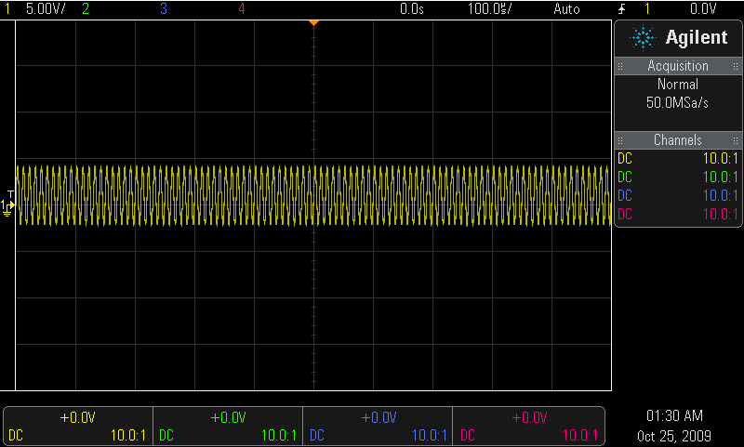
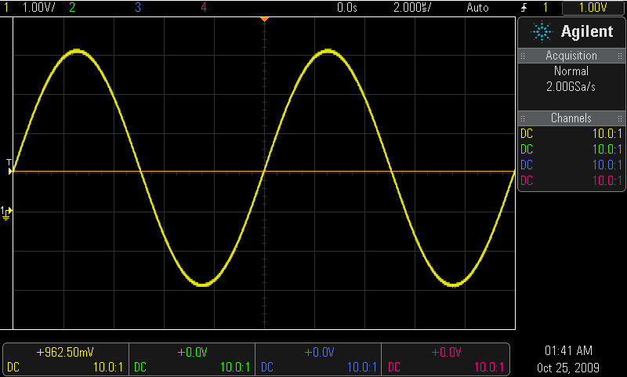
Properly Scaling the Waveform
- Too many cycles displayed.
- Amplitude scaled too low.
Trigger Level
Initial Setup Condition (example)
Optimum Setup Condition
Adjust V/div knob until waveform fills most of the screen vertically.
Adjust vertical Position knob until waveform is centered vertically.
Adjust s/div knob until just a few cycles are displayed horizontally.
Adjust Trigger Level knob until level set near middle of waveform vertically.
Setting up the scope’s waveform scaling is an iterative process of making front panel adjustments until the desired “picture” is displayed on-screen.
Notes:
Properly Scaling the Waveform
Setting up the scope’s waveform scaling is typically an iterative process. For example, assume that from the initial scaling we can see that the waveform is scaled with a relatively low amplitude and with too many cycles on screen as shown in the screen-shot on the left. In this case, we can see that the amplitude of the plotted waveform is only about 1 division high. Turn the Volt/division knob to increase the scaling of the waveform. If you turn the knob the wrong direction, the vertical scaling of the waveform will get smaller. Simply turn it the other direction until the waveform is scaled such that the height of the waveform covers more than half of the screen. Note that if you press the V/div knob, you can then adjust the V/div setting with a much “finer” adjustment granularity in order to fill most of the screen with the waveform for more accurate and precise measurements.
If the input signal has DC offset (waveform will be shifted above or below center-screen), then you may also need to turn the vertical position knob to center the waveform on-screen.
For proper horizontal scaling, turn the sec/division knob – sometimes called the timebase control – until a few cycles of the waveform are displayed on-screen. But if you want to view just a fast edge on a digital signal, set the sec/division setting a low value in order to view just the fast rising or falling edge with a high degree of horizontal resolution.
Lastly, you may need to adjust the trigger level to obtain a stable display. When you turn the trigger level knob, a horizontal trigger level indicator (similar to a voltage cursor) will appear to show the actual trigger level. The proper trigger level setting is typically around 50% of the vertical amplitude of the signal. One quick way to set the trigger level to 50% on a repetitive input signal is to simply press the trigger level knob. We will discuss triggering in more detail next.
Note that after adjusting the vertical, horizontal, and trigger level controls, you may need to go back and re-adjust some of the settings until you see the picture that you want to see.
Note that another fast and easy way to set up oscilloscope scaling on simple repetitive input signals is to use the scope’s Autoscale feature. However, the Autoscale function does not always work on more complex signals. And if you use this feature of the scope, you may never learn how to effectively use a scope when manual adjustments are required. In addition, your professor has the ability to disable the Autoscale feature by downloading a command to the scope.
Note to professor: You can disable the Autoscale feature by downloading the “:AUToscale DISable” command via a USB or LAN connection. After downloading this command to the scope, the Autoscale feature will be permanently disabled until you download the “enable” command (:AUToscale ENABle).

Slide 14
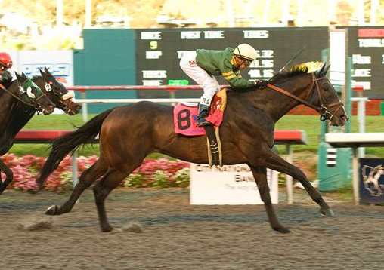
Understanding Oscilloscope Triggering
Triggering is often the least understood function of a scope, but is one of the most important capabilities that you should understand.
Think of oscilloscope “triggering” as “synchronized picture taking”.
One waveform “picture” consists of many consecutive digitized samples.
“Picture Taking” must be synchronized to a unique point on the waveform that repeats.
Most common oscilloscope triggering is based on synchronizing acquisitions (picture taking) on a rising or falling edge of a signal at a specific voltage level.
A photo finish horse race is analogous to oscilloscope triggering
Notes:
Understanding Oscilloscope Triggering
Triggering is often the least understood function of a scope, but is one the most important capabilities of a scope that you should understand, especially if you need to monitor very complex signals. You can think of oscilloscope triggering as “synchronized picture taking”. And one waveform picture actually consists of many individual and consecutive digitized samples.
When monitoring a repetitive input signal, which is typical, the oscilloscope performs repetitive acquisitions (or repetitive picture taking) to show a “live” picture of your input signal. This repetitive picture taking of the oscilloscope must be synchronized to a unique point on the input signal in order to show a stable waveform on the scope’s display.
Although some scopes have various advanced triggering modes to choose from, the most common type of triggering is to trigger the scope when the input signal crosses a particular voltage threshold level in either a positive or negative direction. We call this “edge triggering”. In other words, the scope triggers (takes pictures) when the input signal changes from a lower voltage level to a higher voltage level (rising edge trigger) or when the input signal changes from a higher voltage level to a lower voltage level (falling edge trigger).
A photo finish of a horse race is analogous to oscilloscope triggering. To accurately record the finish of the race, the camera’s shutter must be synchronized to when the lead horse’s nose crosses the finish line in the forward direction.

Slide 15
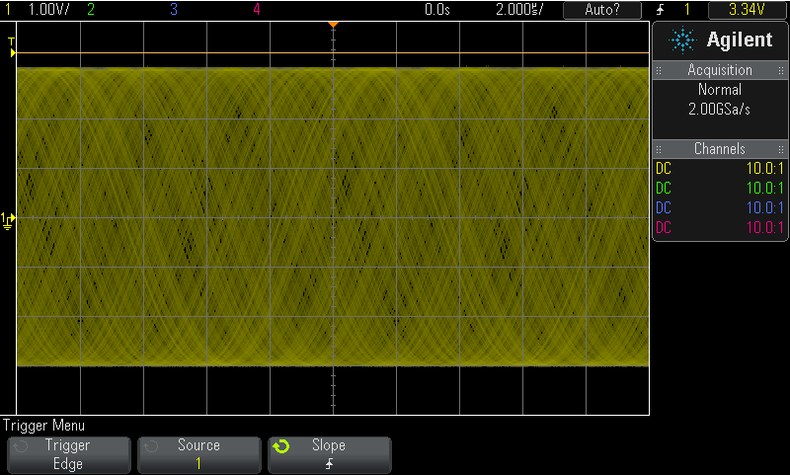
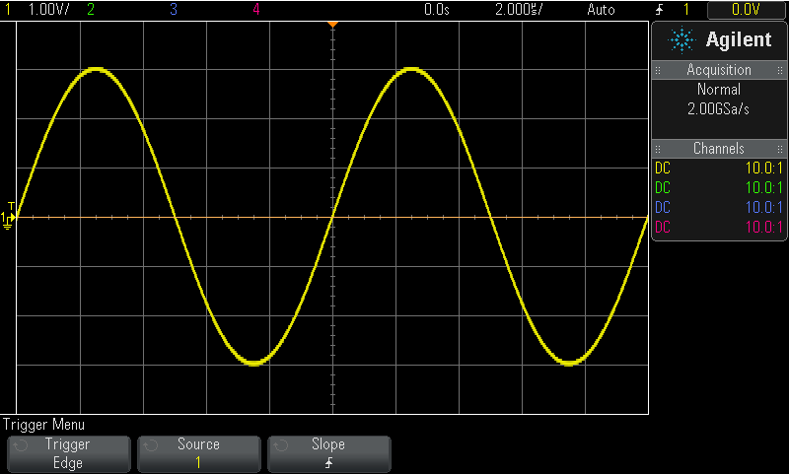
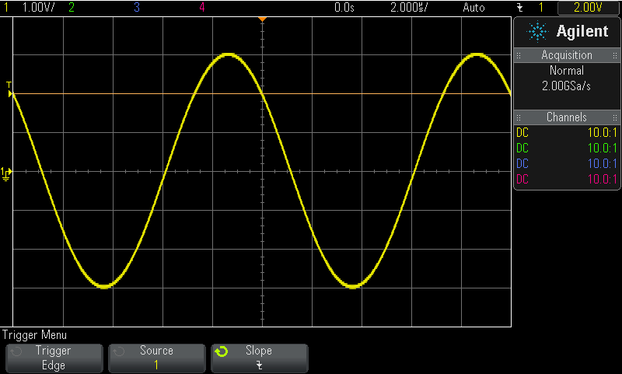
Triggering Examples
Trigger level set above waveform
Trigger Point
Trigger Point
Untriggered
(unsynchronized picture taking)
Trigger = Rising edge @ 0.0 V
Negative Time
Positive Time
Trigger = Falling edge @ +2.0 V
Default trigger location (time zero) on DSOs = center-screen (horizontally)
Only trigger location on older analog scopes = left side of screen
Notes:
Triggering Examples
In this slide we show three examples of oscilloscope triggering. In the screen-shot on the left, the scope’s trigger level is set above the waveform. In this case the input signal never crosses the trigger threshold level in any direction. Using the scope’s default “Auto” trigger mode, the scope then takes asynchronous pictures of the input signal and we observe what appears to be an unstable waveform. This is actually an example of not triggering.
When using the “Auto” trigger mode, the scope generates “automatic” asynchronous triggers if a real trigger event doesn’t occur after a specified time-out period. Although our waveform is not synchronized and appears unstable, at least we can see how the waveform is scaled vertically. If we had used the scope’s “Normal” trigger mode with the trigger level set above the waveform, the scope would not take any pictures and we wouldn’t observe any waveforms – stable or unstable.
In the screen-shot in the middle, the scope was setup to trigger on rising edges of the input signal with the trigger level set at the approximate 50% level. In this case, we can see a rising edge of the input signal at exactly center-screen. This is the scope’s default trigger location.
In the screen-shot on the right, the scope was setup to trigger on falling edges of the input signal with the trigger level set at a higher level (+2.0 V) that is closer to the positive peak of the waveform. Now we can see a falling edge of the input signal at exactly center-screen. Again, this is the trigger point.
Although the default trigger localization on all digital oscilloscopes is at center-screen (horizontally), you can re-position the trigger location to the left or right by adjusting the horizontal delay knob – sometimes called the horizontal position knob. Older technology analog scopes are only able to trigger at the left side of the screen. This means that analog oscilloscopes are only capable of showing portions of waveforms that occur after the trigger event – sometimes called “positive time data”. But DSOs are able to show portions of waveforms both before (negative time or pre-trigger data) and after (positive time data) the trigger event. Observing pre-trigger data can be useful for analyzing waveform data that may have lead up to a specific error trigger condition.

Slide 16
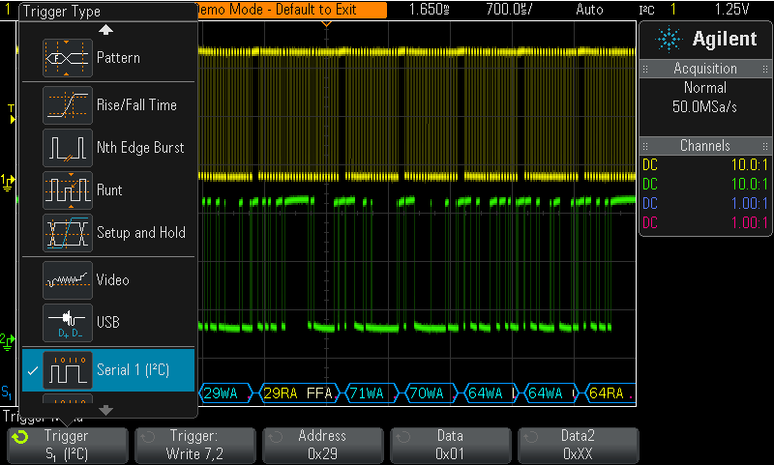
Advanced Oscilloscope Triggering
Example: Triggering on an I²C serial bus
Most of your undergraduate lab experiments will be based on using standard “edge” triggering
Triggering on more complex signals requires advanced triggering options.
Notes:
Advanced Oscilloscope Triggering
Although you will primarily be using simple rising or falling edge triggering for most of your assigned undergraduate EE and physics experiments, some of today’s more advanced oscilloscopes offer more advanced triggering modes in order to synchronize acquisitions (waveform picture taking) on more complex signals.
In this particular example we are showing a complex I²C serial bus clock and data signal. Triggering on a unique serial bus condition such as a write operation to a specific address requires I²C triggering. Simple edge triggering is only able to trigger on random edge crossings.

Slide 17
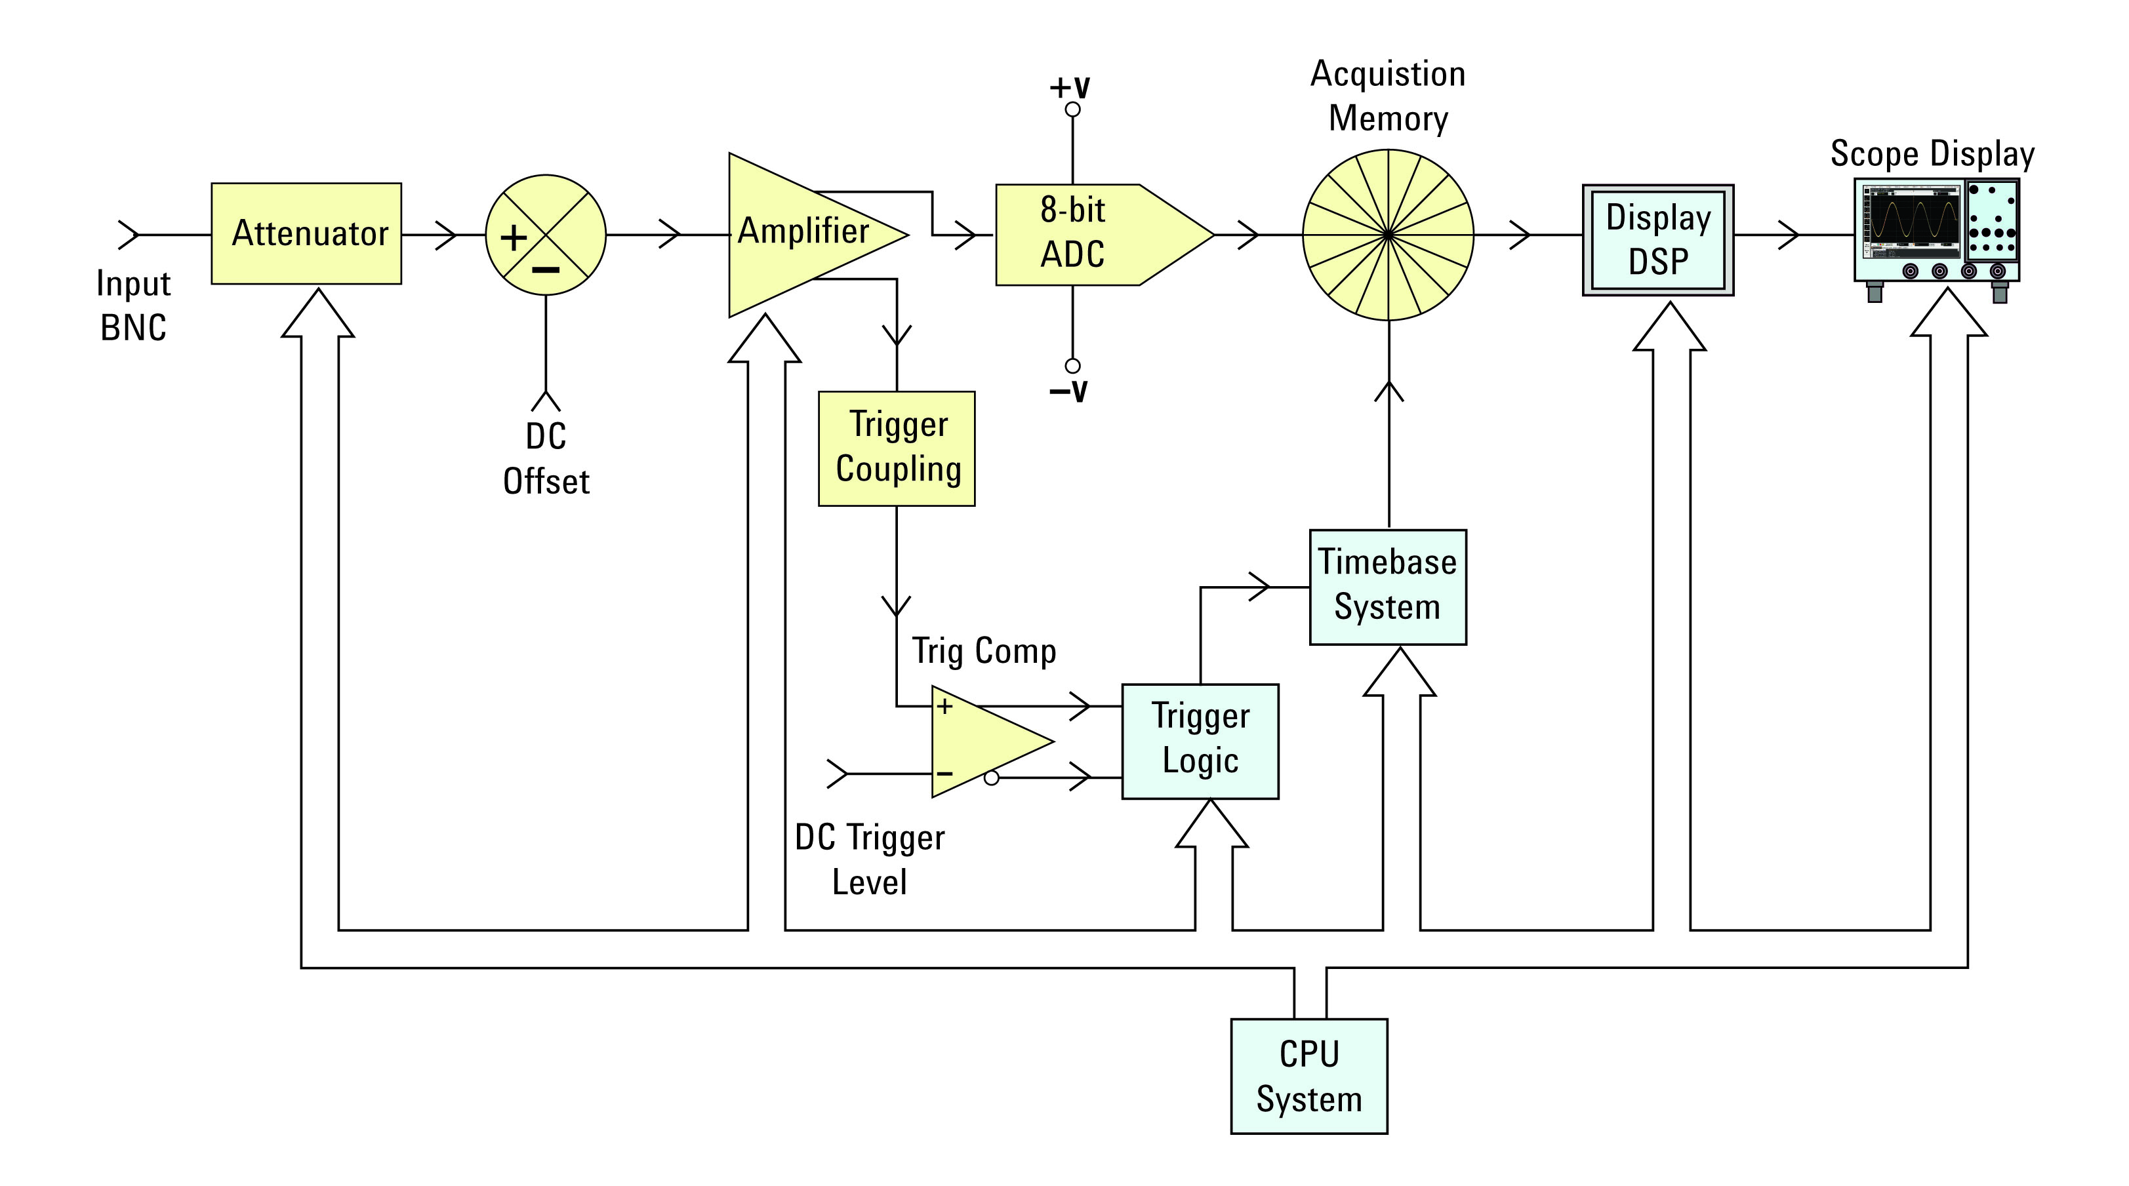
Oscilloscope Theory of Operation
Yellow = Channel-specific blocks
Blue = System blocks (supports all channels)
DSO Block Diagram
Notes:
Oscilloscope Theory of Operation
At the heart of all digital storage oscilloscopes (DSOs) are the scope’s analog-to-digital converter (ADC) and acquisition memory. This is essentially the component of the scope that takes waveform pictures. The ADC takes an analog input signal and then converts the analog voltage value at a particular point in time to a digital binary value. This is typically accomplished with 8 bits of vertical resolution in most of today’s DSOs. In other words, typical DSOs can resolve voltage values of input signals within 1 part in 256.
The “Attenuator”, “DC offset”, and “Amplifier” blocks perform pre-scaling on the input signal in order to scale the input signal to be within the fixed dynamic range of the ADC. When you adjust the V/div knob, this sets up specific voltage-divider networks in the attenuator block to possibly reduce the amplitude of the input signal, and also sets the gain of the amplifier. When you adjust the vertical position knob, this changes the DC offset. Again, this is to bring the input signal that may have a specific amount of dc offset to be within the fixed dynamic range of the ADC.
The trigger and timebase blocks control when and how fast the ADC samples (takes pictures). The trigger signal actually tells the timebase block when to stop taking acquisitions (pictures). For example, if the scope has a memory depth of 1000 points (or samples per acquisition), and if the scope has been setup to trigger at exactly center screen, the timebase block enables the ADC/memory blocks to continuously sample the input or order fill at least half of the memory. Once the trigger event occurs, the timebase block allows the ADC/memory blocks to take 500 additional samples before sampling is stopped. In this case, the first 500 samples in acquisition memory represent waveform data before the trigger event, while the last 500 samples in acquisition memory represent waveform data after the trigger event.
When an acquisition cycle has been completed, stored samples in the acquisition memory must then be processed for display. Older DSOs simply used the scope’s CPU system to read the data out of acquisition memory – one sample at a time - , process the data, and then re-store the sampled data into display memory. This was a time-consuming process that sometimes resulted in slow waveform update rates – especially when processing deep memory records. Many of today’s newer DSOs use dedicated and custom DSPs to quickly process/digitally-filter data and then effectively “pipe-line” waveform data into display memory to thereby improve throughput and waveform update rates.

Slide 18
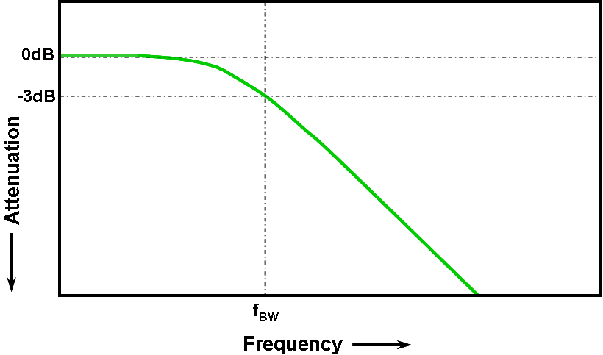
Oscilloscope Performance Specifications
“Bandwidth” is the most important oscilloscope specification
Oscilloscope “Gaussian” Frequency Response
All oscilloscopes exhibit a low-pass frequency response.
The frequency where an input sine wave is attenuated by 3 dB defines the scope’s bandwidth.
-3 dB equates to ~ -30% amplitude error (-3 dB = 20 Log ).
Notes:
Oscilloscope Performance Specifications
Oscilloscope have many different specifications, but the most important specification of an oscilloscope is its bandwidth. The highest input frequency that a scope can capture and accurately measure is based on the bandwidth specification of the scope. But a scope cannot make accurate measurements on signals of the same frequency as the bandwidth frequency.
All scopes exhibit a low-pass frequency response – typically called a Gaussian response. A Gaussian frequency response closely approximates a single-pole low-pass filter. You may have plotted responses similar to this in some of your EE classes, and may know of these as Bode plots.
As the frequency of an input signal increases, the scope will begin to attenuate the input signal and then begin to make inaccurate measurements. The frequency at which a sine wave input signal is attenuated by 3 dB is the bandwidth of the scope. But 3 dB of attenuation is equivalent to approximately 30% attenuation based on the 20 Log(Vo/Vi) formula .

Slide 19
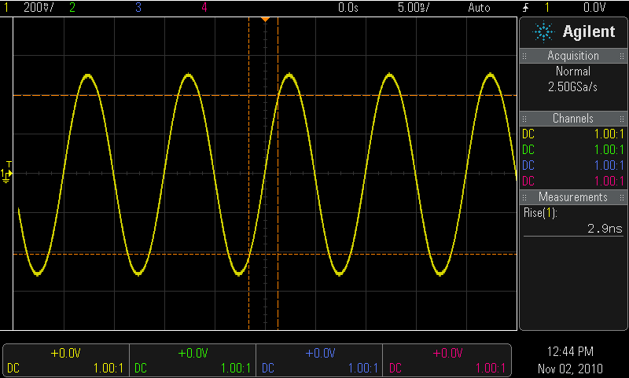
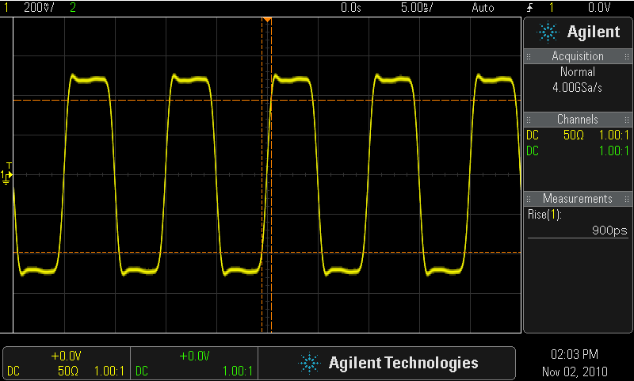
Selecting the Right Bandwidth
Input = 100-MHz Digital Clock
Response using a 100-MHz BW scope
Response using a 500-MHz BW scope
Required BW for analog applications: ≥ 3X highest sine wave frequency.
Required BW for digital applications: ≥ 5X highest digital clock rate.
More accurate BW determination based on signal edge speeds (refer to “Bandwidth” application note listed at end of presentation)
Notes:
Selecting the Right Bandwidth
Since input sine waves are attenuated by approximately 30% (-3 dB) at the bandwidth frequency of the scope, you should never use a scope of a specific bandwidth to test signals of the same frequency.
For pure analog/RF measurement applications (sine waves), it is recommended that the scope’s bandwidth be at three times higher than the highest input sine wave frequency that you may want to measure. At 1/3 the scope’s bandwidth, signals are typically minimally attenuated.
For digital applications, which are actually more common today, your scope’s bandwidth should be at least fives times higher than the highest clock rate in your system. If you remember from some of your EE classes, all signals – including digital clock signals – are composed of multiple sine waves. If your scope’s bandwidth is at least five times higher than the highest clock rate, then it will be able to capture up to the fifth harmonic with minimal attenuation.
This slide shows two different bandwidth oscilloscopes capturing the same 100 MHz digital clock signal. The screen-shot on the left shows what a 100 MHz digital clock looks like when captured by a 100 MHz bandwidth oscilloscope. The higher harmonics of this signal have been attenuated to such a degree that all that virtually remains is the fundamental frequency component of this clock signal (100 MHz sine wave).
The screen-shot on the right shows what the same 100 MHz clock signal looks when captured by a 500 MHz bandwidth scope. The 500 MHz bandwidth scope is able to not only capture the 100 MHz fundamental frequency component, but also the 3rd and 5th harmonics with reasonable accuracy.
Note that the 5X factor for digital applications is actually just a “rule-of-thumb” recommendation. There is actually a more accurate method to determine the appropriate bandwidth based on actual frequency content in high speed edges – regardless of the clock rate. If you are interested in learning about this more accurate method, refer the application note listed at the end of this presentation titled, “Evaluating Oscilloscope Bandwidths for your Applications”.

Slide 20
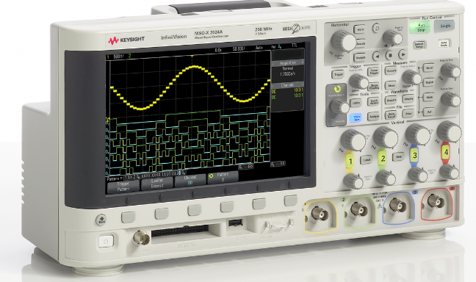
Other Important Oscilloscope Specifications
Sample Rate (in samples/sec) – Should be ≥ 4X BW
Memory Depth – Determines the longest waveforms that can be captured while still sampling at the scope’s maximum sample rate.
Number of Channels – Typically 2 or 4 channels. MSO models add 8 to 32 channels of digital acquisition with 1-bit resolution (high or low).
Waveform Update Rate – Faster update rates enhance probability of capturing infrequently occurring circuit problems.
Display Quality – Size, resolution, number of levels of intensity gradation.
Advanced Triggering Modes – Time-qualified pulse widths, Pattern, Video, Serial, Pulse Violation (edge speed, Setup/Hold time, Runt), etc.
Notes:
Other Important Oscilloscope Specifications
Although bandwidth is the most important oscilloscope specification, there are other specifications that you should consider if you are ever tasked with selecting and purchasing an oscilloscope. These include:
Sample Rate – should be at least 4X the scope’s bandwidth
Memory Depth – determines the length of a waveform that be captured
Number of Channels – Most scopes come in 2-channel and 4-channel models. But MSO models add additional logic timing channels of acquisition in order to monitor and test more complex sets of digital signals.
Waveform Update Rate – Faster update rates means faster picture taking, which can improve the scope’s probability of capturing infrequent events, such as glitches.
Display Quality – consists of display size, resolution, and number of levels of intensity gradation. Intensity gradation can be an important characteristic of a scope’s display quality in order to view and make intuitive judgments about random noise and jitter.
Advance Triggering Modes- enables the scope to synchronize on more complex signals, such as serial bus signals.

Slide 21
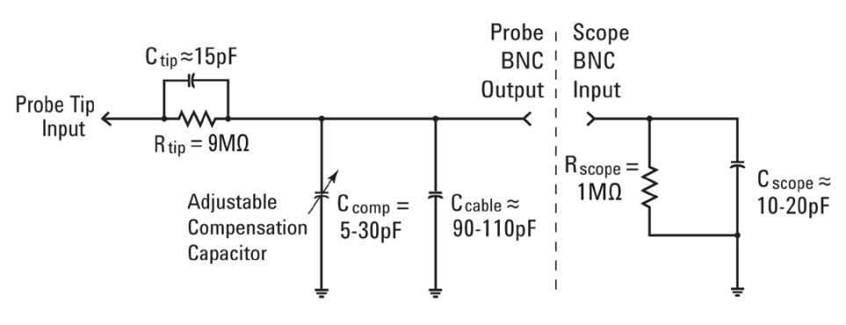

Probing Revisited - Dynamic/AC Probe Model
Passive 10:1 Probe Model
C_{scope} and C_{cable} are inherent/parasitic capacitances (not intentionally designed-in)
C_{tip} and C_{comp} are intentionally designed-in to compensate for C_{scope} and C_{cable}.
With properly adjusted probe compensation, the dynamic/AC attenuation due to frequency-dependant capacitive reactances should match the designed-in resistive voltage-divider attenuation (10:1).
Where C_{parallel} is the parallel combination of C_{comp} + C_{cable} + C_{scope}
Notes:
Probing Revisited – Dynamic/AC Probe Model
Earlier we discussed the static/DC model of a standard 10:1 passive probe. For the static/DC model, we significantly simplified the model by eliminating the capacitive elements/components. This left us with a simple 2-resistor voltage-divider network.
Let’s now address the dynamic/AC model of the probe/scope and take into account the affects of the capacitive elements of this model. C_{cable}, which is the capacitance of the probe cable, and C_{scope}, which is the capacitance on the input of the scope’s BNC, are inherent (or parasitic) capacitances in this probe model. This means that these elements were not intentionally designed-in – but are just an unfortunate fact of life. C_{tip} and C_{comp}, which stands for the variable compensation capacitor, are intentionally designed-in to compensate for the natural/inherent capacitive elements. When C_{comp} is properly tuned, the capacitive reactance of C_{tip} relative to the parallel combination of C_{comp} + C_{cable} + C_{scope} should have the same attenuation ratio as the attenuation due to the resistive components in the model. In order words. X_{C-tip} should be 9X that of X_{C-parallel}. This will establish the same 10:1 reduction in amplitude of signals received at the scope’s input BNC under AC/dynamic conditions as the resistive network under DC conditions.
Also note that when X_{C-tip} is exactly 9X that of X_{C-parallel}, the RC time-constant of R_{tip} and C_{tip} will be equal to the RC time-constant of R_{scope} and C_{parallel}.

Slide 22
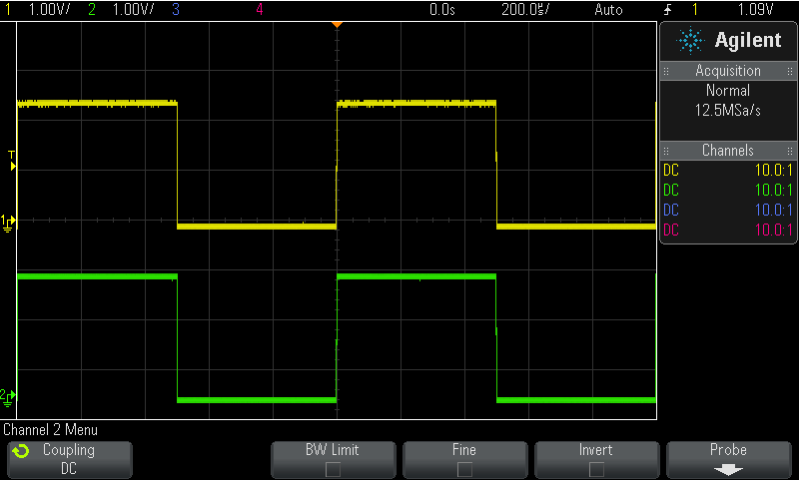
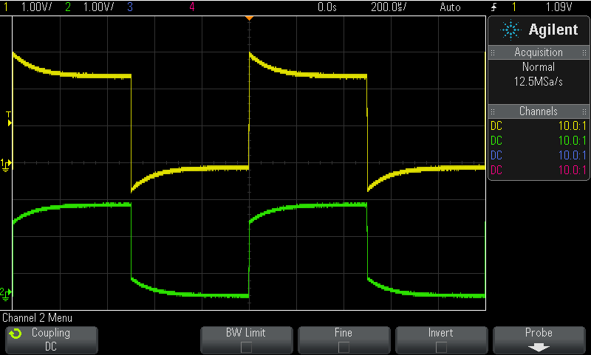
Compensating the Probes
Proper Compensation
Channel-1 (yellow) = Over compensated
Channel-2 (green) = Under compensated
Connect Channel-1 and Channel-2 probes to the “Probe Comp” terminal (same as Demo2).
Adjust V/div and s/div knobs to display both waveforms on-screen.
Using a small flat-blade screw driver, adjust the variable probe compensation capacitor (C_{comp}) on both probes for a flat (square) response.
Notes:
Compensating the Probes
To compensate your probes, first connect the probes of your scope to the “Probe Comp” terminal on the front panel of the scope. This is the same terminal that is also labeled “Demo2”. When the training signals are not turned on, there will always be a 1 kHz square wave present on this terminal to be used for probe compensation.
Next, set up the scope to display a few cycles of this signal on the scope’s display. If your probes are properly compensated, you should observe a near-perfect square wave on each channel of the scope as shown in the screen-shot on the left. If your probes are not properly compensated, you will observe waveform distortion as shown in the screen-shot on the right. To correct for this distortion, adjust the variable compensation capacitor on each probe using a small flat-blade screw driver until you observe distortion-free waveforms (perfect square wave).
Once your probes have been properly compensated, you should not need to repeat this process the next time you use this particular scope with these particular probes. However, it is good practice to occasionally connect your probes to the probe compensation terminal to insure that they are still properly adjusted.

Slide 23
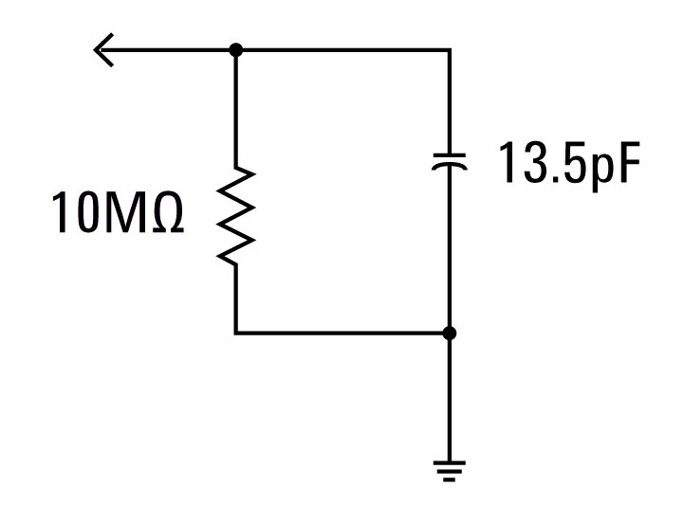
Probe Loading
The probe and scope input model can be simplified down to a single resistor and capacitor.
Any instrument (not just scopes) connected to a circuit becomes a part of the circuit under test and will affect measured results… especially at higher frequencies.
“Loading” implies the negative affects that the scope/probe may have on the circuit’s performance.
C_{Load}
R_{Load}
Probe + Scope Loading Model
Notes:
Probe Loading
Besides properly compensating your 10:1 passive probes in order to achieve the most accurate oscilloscope measurements, another issue that must be considered is probe loading. In other words, will connecting the probe and scope to your device-under-test (DUT) change your circuit’s behavior? When you connect any instrument to your circuit, the instrument itself (including the probe) becomes a part of your DUT and can “load” or change the behavior of your signals to some degree. To determine the degree of probe/scope loading, our probe/scope model can be simplified down to single resistor and capacitor as shown in this slide. Let’s now compute the values of R_{load} and C_{load}.

Slide 24
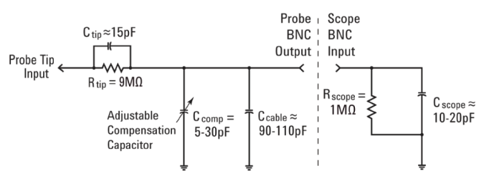
Assignment
C _{Load} = ?
Assuming C_{scope} = 15pF, C_{cable} = 100pF and C_{tip} = 15pF, compute C_{comp} if properly adjusted. C_{comp} = ______
Using the computed value of C_{comp}, compute C_{Load}. C_{Load} = ______
Using the computed value of C_{Load}, compute the capacitive reactance of C_{Load} at 500 MHz. X_{C-Load} = ______
Notes:
Assignment
Assume the following:
C_{scope} = 15 pF
C_{cable} = 100 pF
C_{tip} = 15 pF
R_{load} is simply the series combination of R_{tip} (9 MΩ) and R_{scope} (1 MΩ), which is 10 MΩ.
Determine C_{comp} (assuming proper compensation) using the capacitive reactance equations presented earlier. Remember that the reactance of C_{tip} should be 9X the reactance of C_{parallel}. Note that this is also the same as equating the RC time-constant of the parallel combination of R_{tip} and C_{tip}, with the parallel combination of the R_{scope} and C_{parallel}. C_{parallel} is simply the parallel combination of C_{comp} + C_{cable} + C_{scope}.
Using the computed value of C_{comp}, determine C_{load}. C_{load} will be the series combination of C_{tip} and C_{parallel}.
After determining R_{load} and C_{load}, you can then include these two parallel components into the model of your circuit under test to determine if there is a simulated/computed difference in signal performance with or without these additional loading components.
Now, determine the capacitive reactance of C_{load} at 500 MHz.
Do you believe that this amount of capacitance reactance (loading) could affect the behavior of some of signals under test at this frequency?
Note that for high frequency applications, using a 10:1 passive probe may NOT be the best solution for accurate measurements due to probe loading. A better solution might be to use an active probe. Active probes typically have much lower input capacitance for high frequency applications. But the trade-off with an active probe is that they cost more than a standard 10:1 passive probe.

Slide 25
Additional Technical Resources Available from Keysight Technologies
Application Note | Publication #
Evaluating Oscilloscope Fundamentals | 5989-8064EN
Evaluating Oscilloscope Bandwidths for your Applications | 5989-5733EN
Evaluating Oscilloscope Sample Rates vs. Sampling Fidelity | 5989-5732EN
Evaluating Oscilloscopes for Best Waveform Update Rates | 5989-7885EN
Evaluating Oscilloscopes for Best Display Quality | 5989-2003EN
Evaluating Oscilloscope Vertical Noise Characteristics | 5989-3020EN
Evaluating Oscilloscopes to Debug Mixed-signal Designs | 5989-3702EN
Evaluating Oscilloscope Segmented Memory for Serial Bus Applications | 5990-5817EN
http://literature.cdn.keysight.com/litweb/pdf/xxxx-xxxxEN.pdf
Insert pub # in place of “xxxx-xxxx”
Notes:
Additional Technical Resources Available from Keysight Technologies
If you are interested in learning more about oscilloscopes and oscilloscope measurements, you can download these documents at no charge using the URL listed in this slide. Simply insert the publication number in place of “xxxx-xxxx”. Alternatively, you can go to Keysight’s website at www.Keysight.com and then enter the publication number into Keysight’s “search engine” box.

